Slide 1


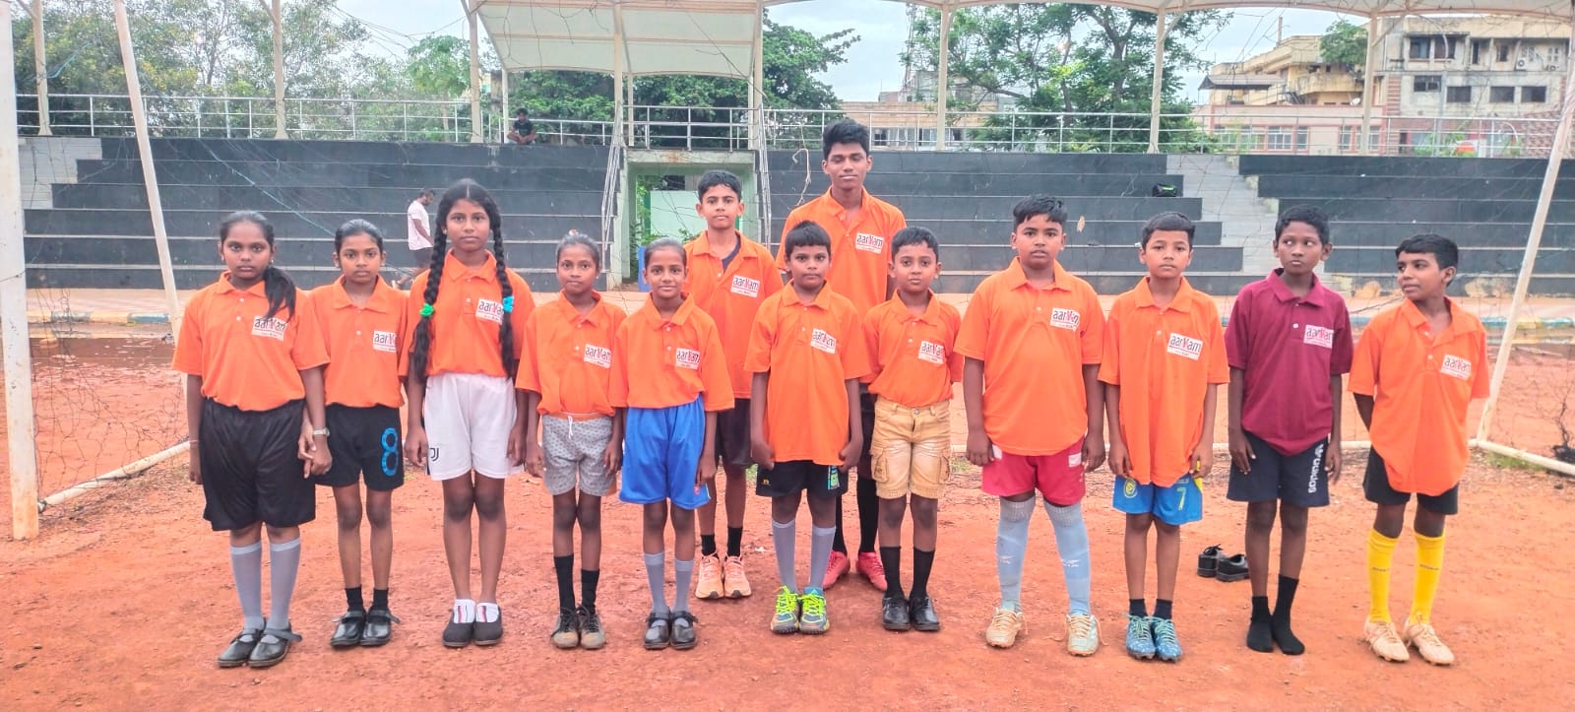
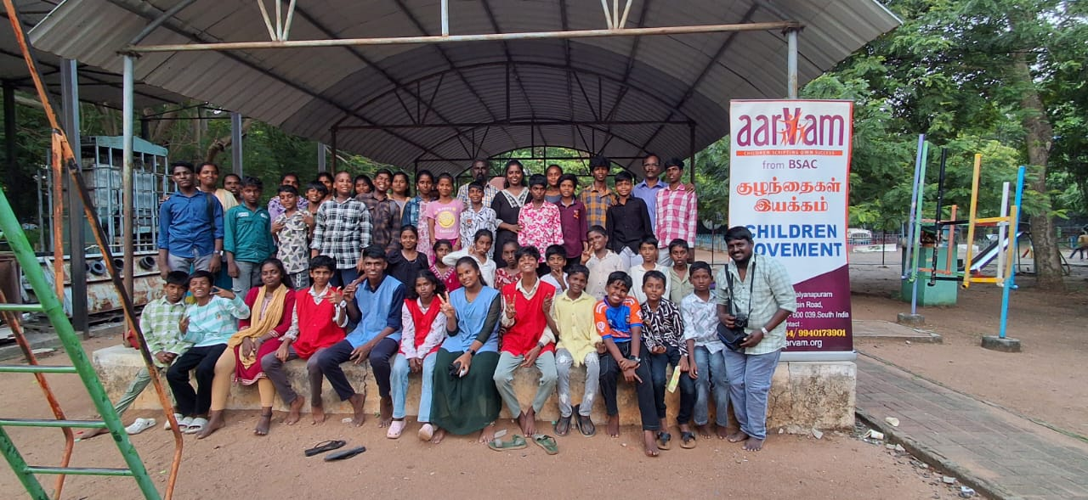
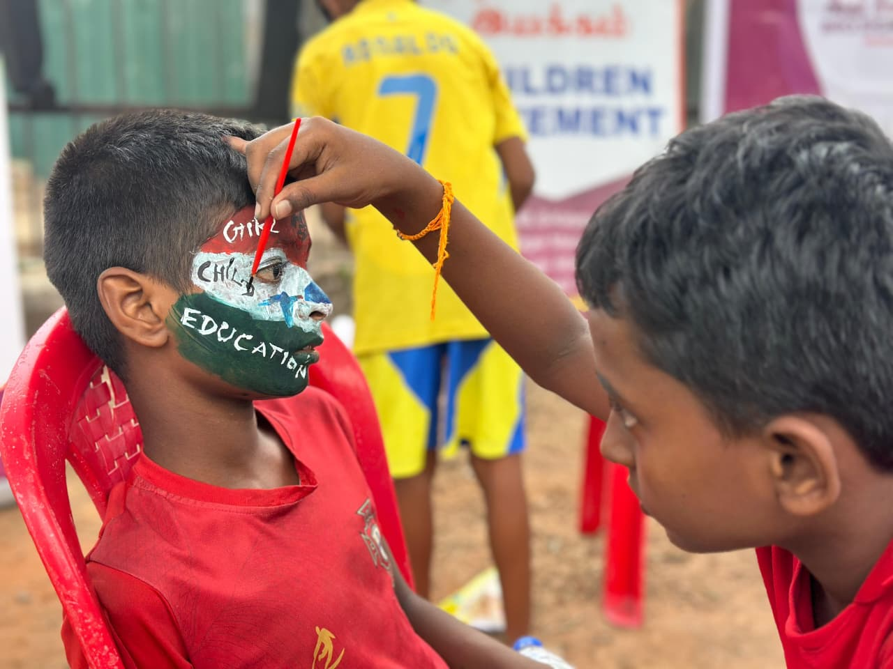
Aarvam – Chennai Smiles Quarterly Report (Sept–Nov 2025)
Submitted by: Bro. Siga Animation Centre, Vyasarpadi
Supported by: Chennai Smiles

Slide 2
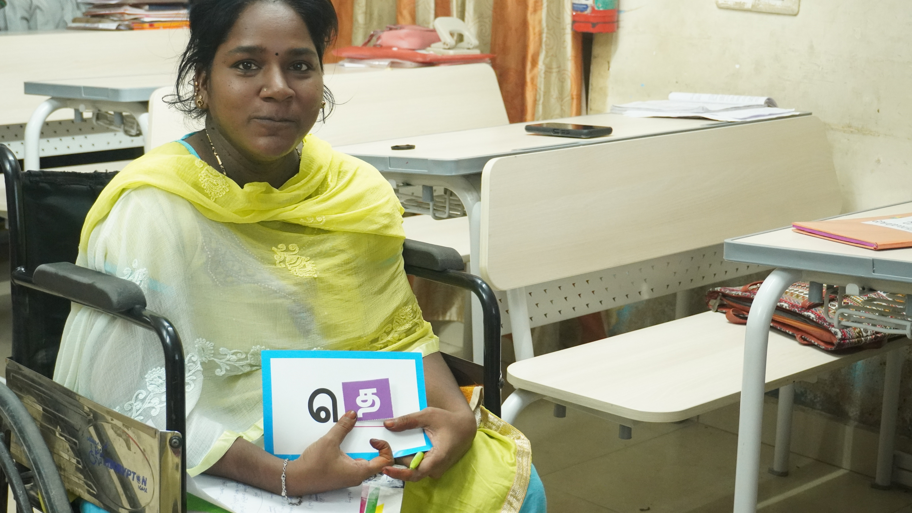
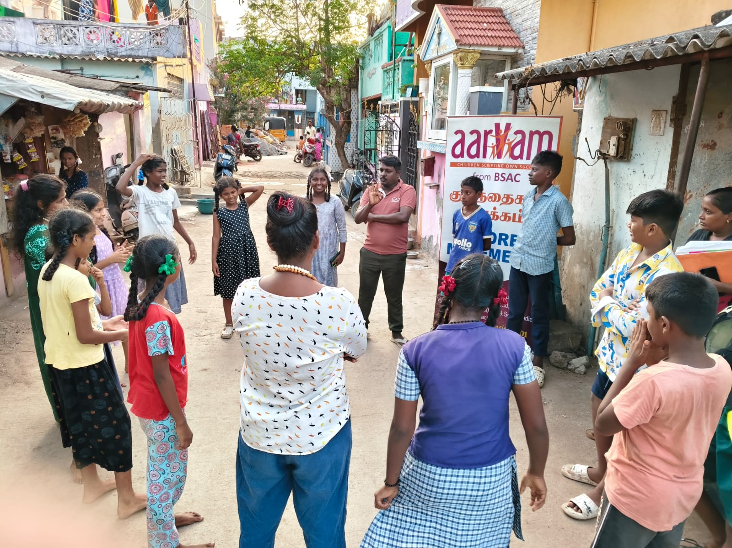
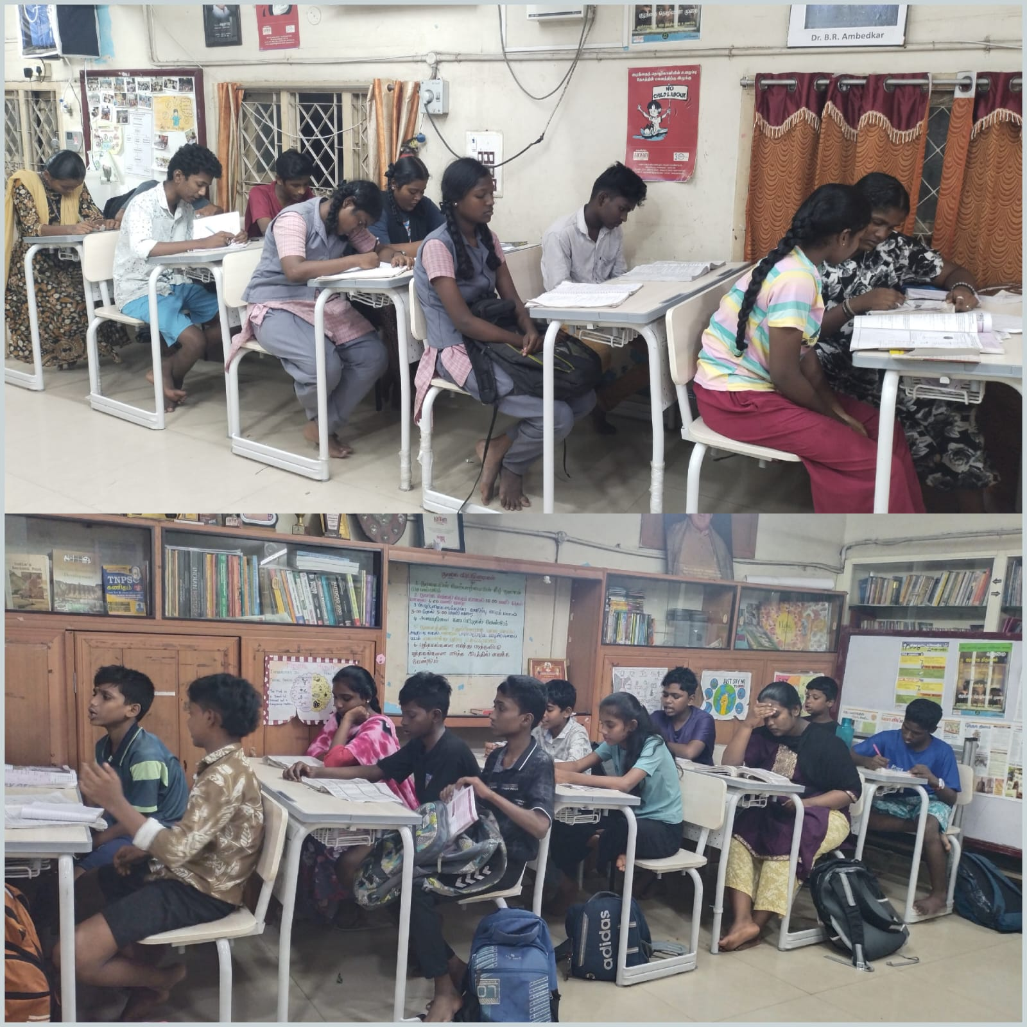
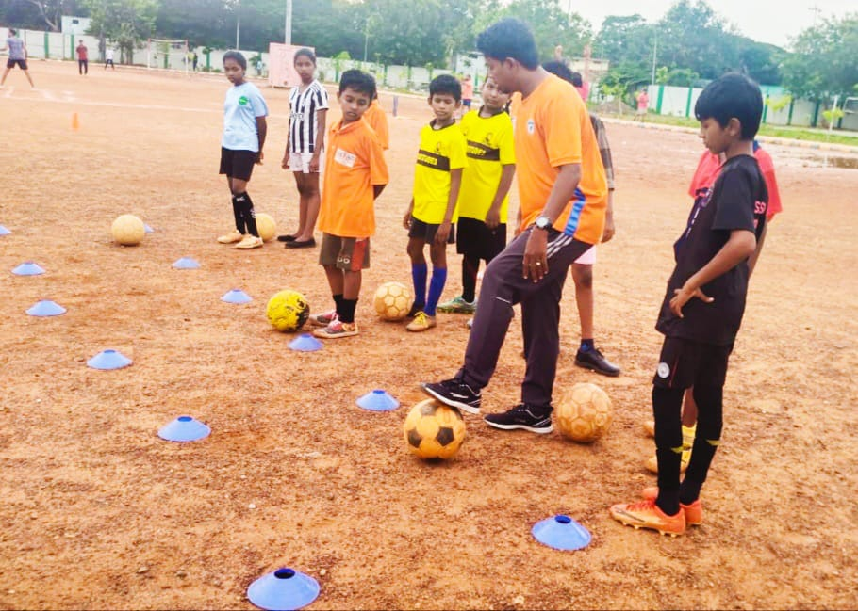
Overview
Focused on holistic development of children, youth, and women through education, arts, mental health, and livelihood programs.
Covered communities in Vyasarpadi, Gummidipoondi, and Thervaikandigai.
Over 650 direct beneficiaries reached this quarter.

Slide 3
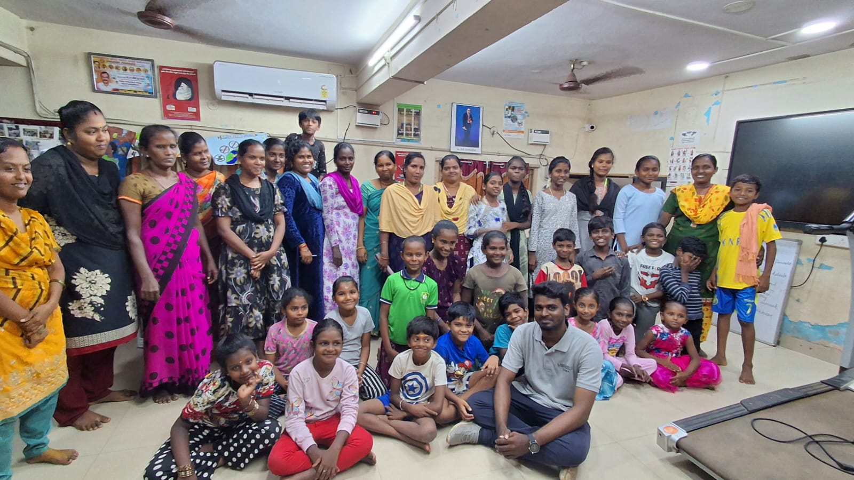
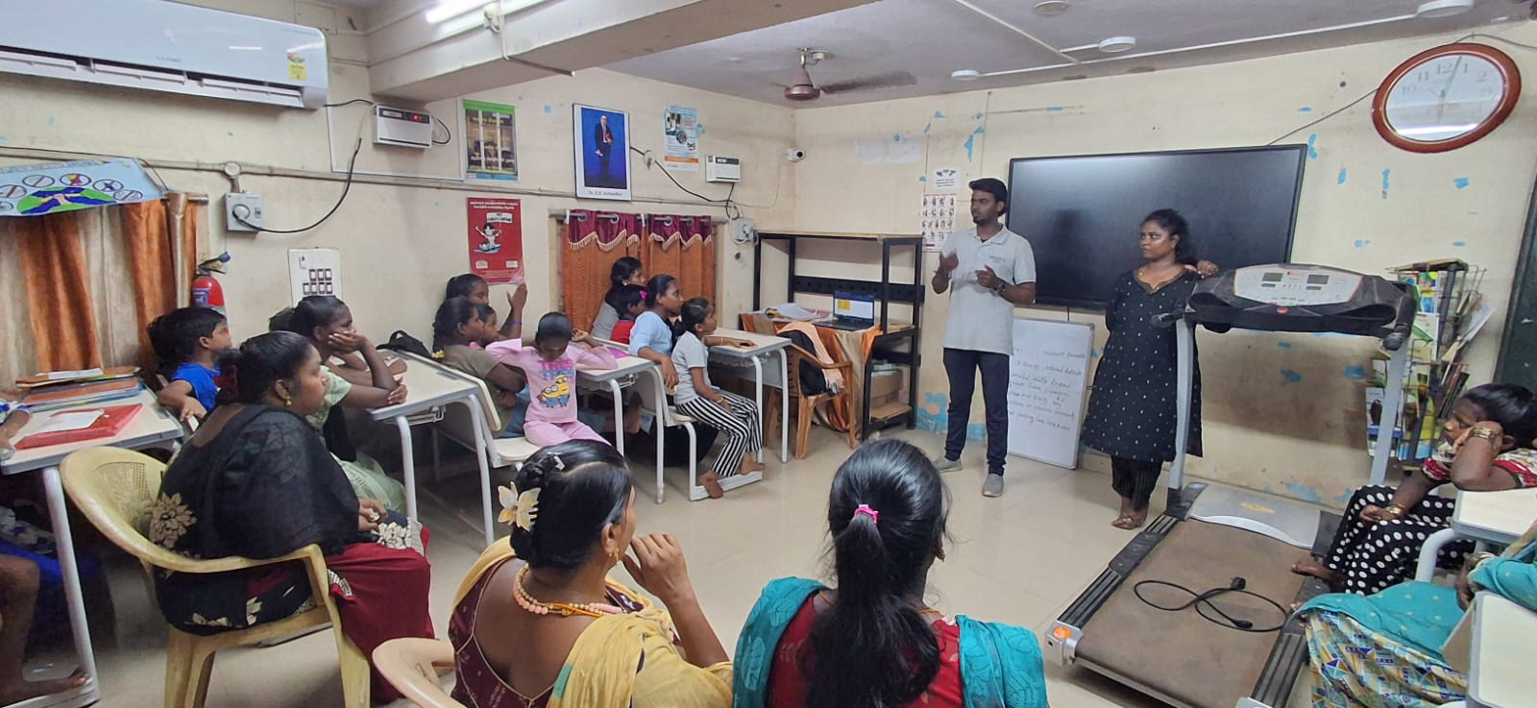
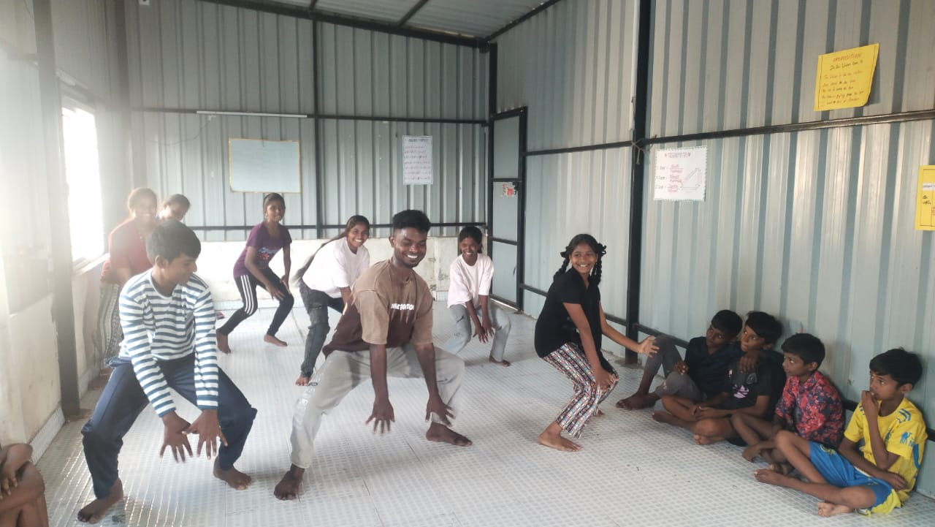
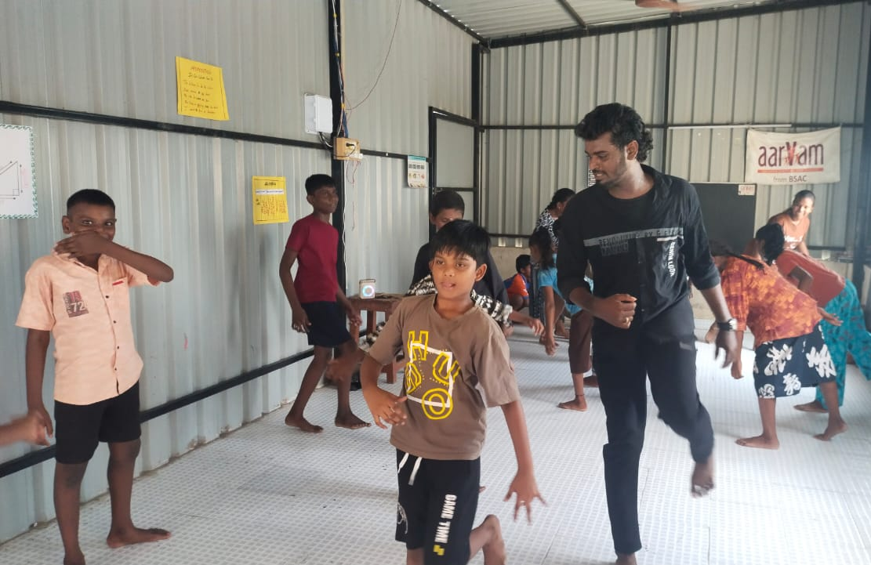
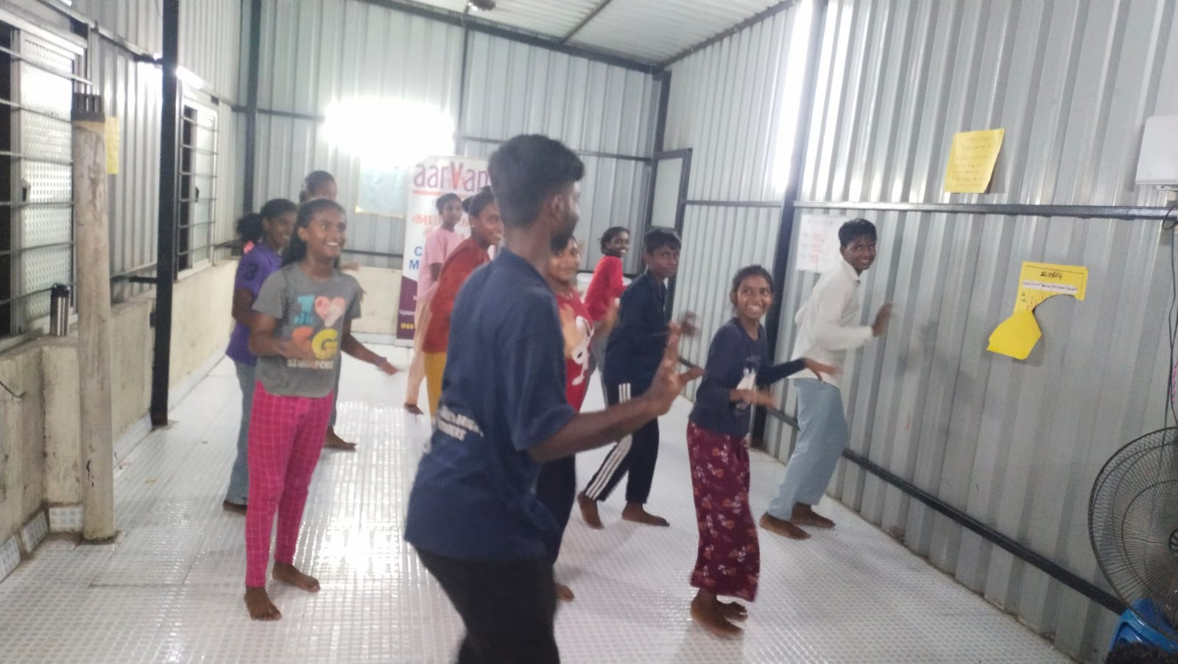
Aarvam Dance Classes (Initiated Aug 30, 2025)
As part of our holistic youth development program, Aarvam launched Dance Classes for children and adolescents to enhance creativity, expression, and confidence.
Classes are held every Saturday and Sunday, led by Mr. Sathish, who is a beneficiary of Aarvam’s Supplementary Education & Children Sangam programs and now mentors youth through dance.
Focus areas include performance skills, participation and cultural expression
Impact: Children show improved self-confidence, creative expression, and active participation in cultural activities. The classes also encourage discipline, collaboration, and positive peer interaction.

Slide 4
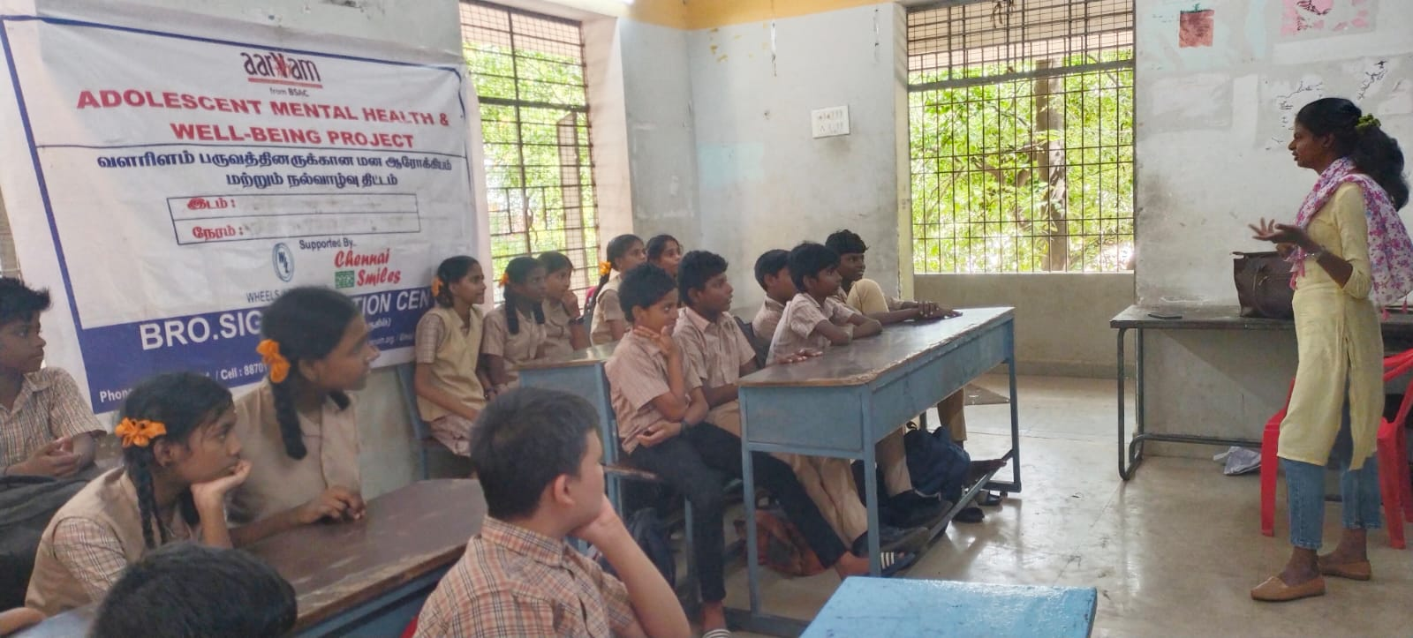
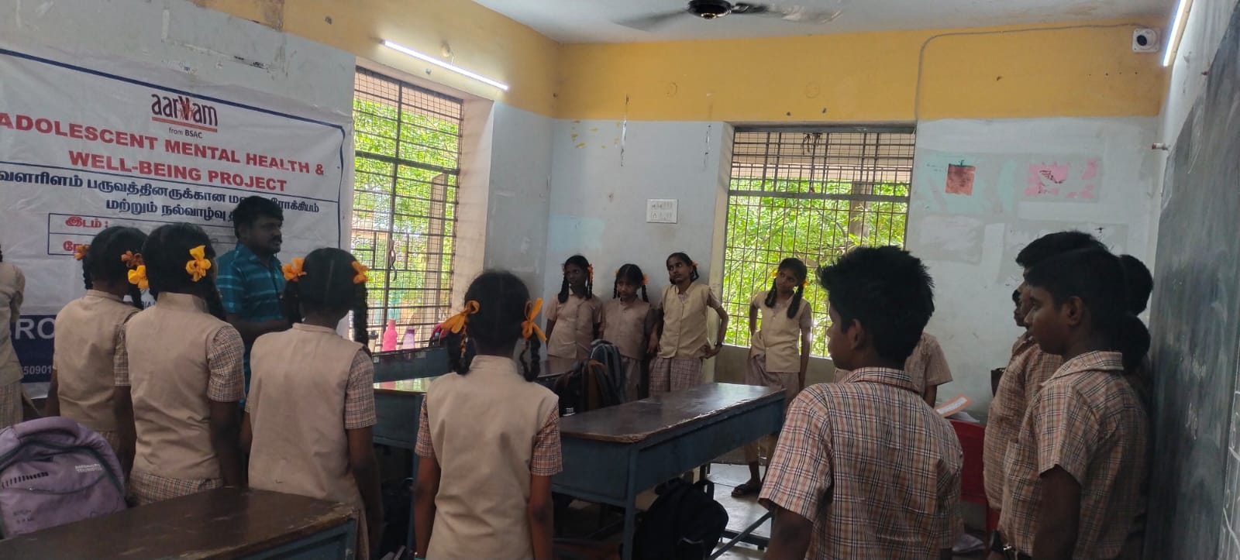
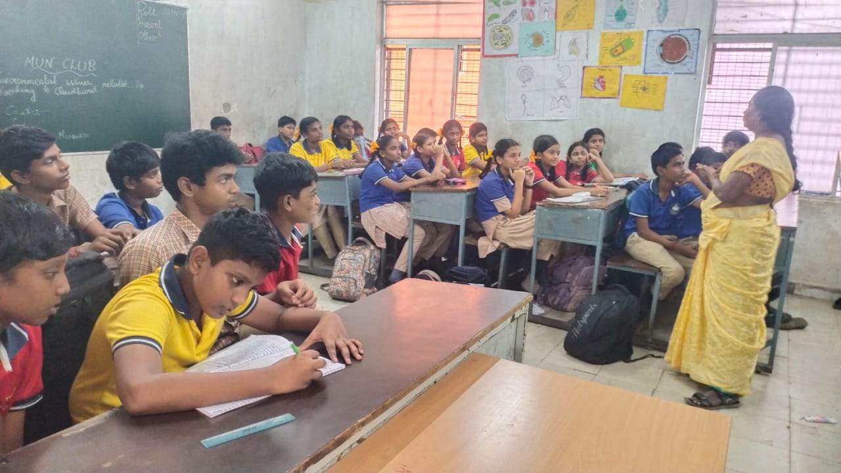
School Mental Health Program
Schools Covered: 3 government schools | Students: 128 adolescents
Focus Areas: Adolescence, emotions, peer connection, and self-awareness
Methods: Interactive sessions with guided reflections and group discussions
Outcomes:
  Improved emotional understanding and peer relationships.
  Teachers observed better behavior and communication in classrooms.

Slide 5
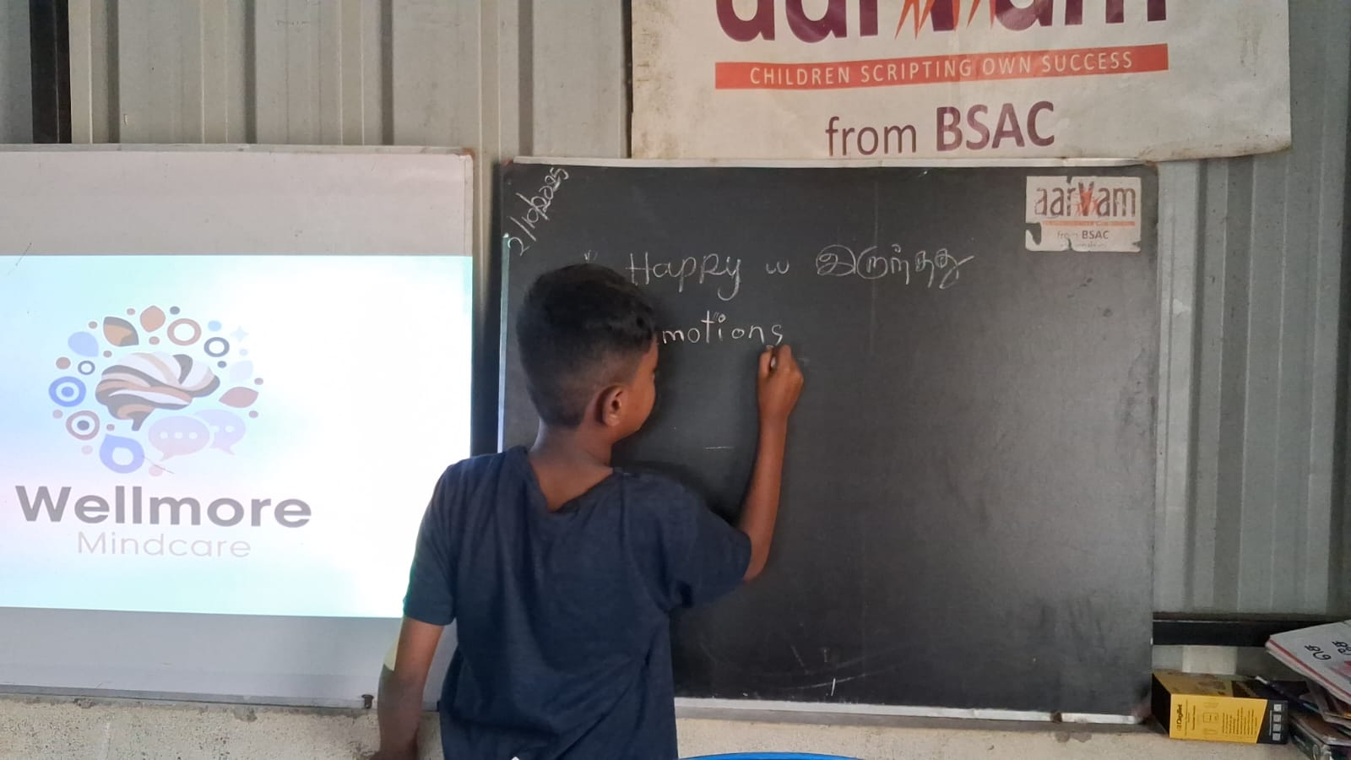
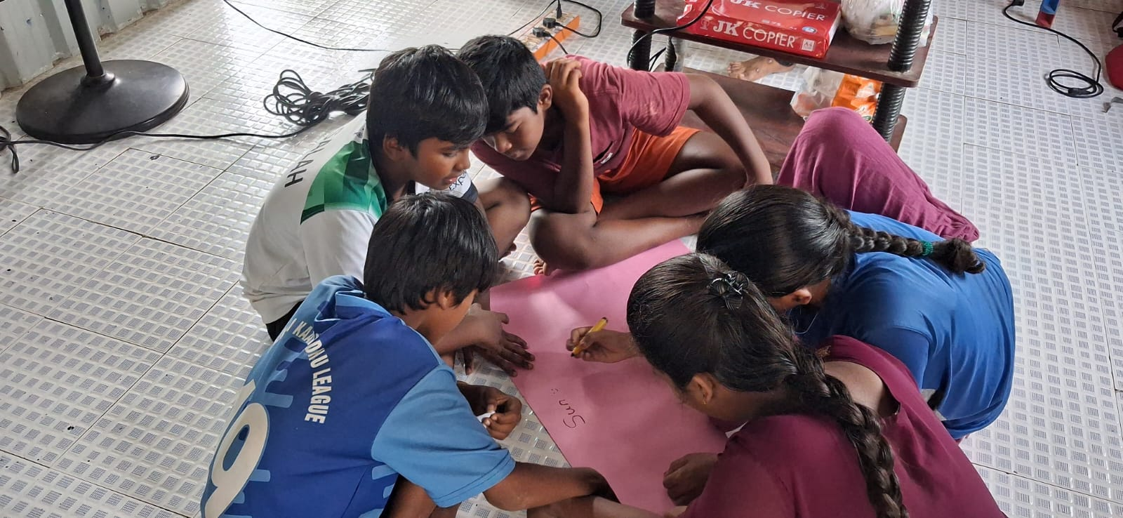
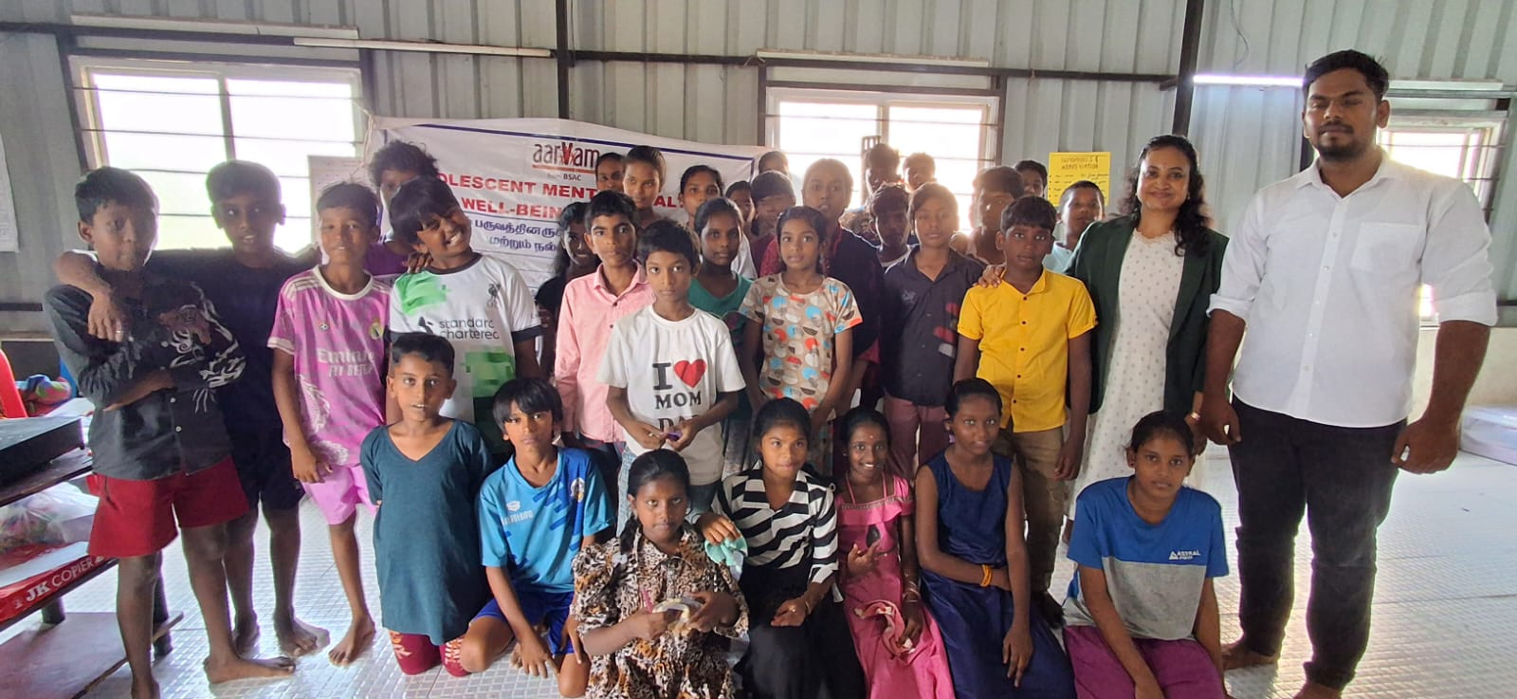
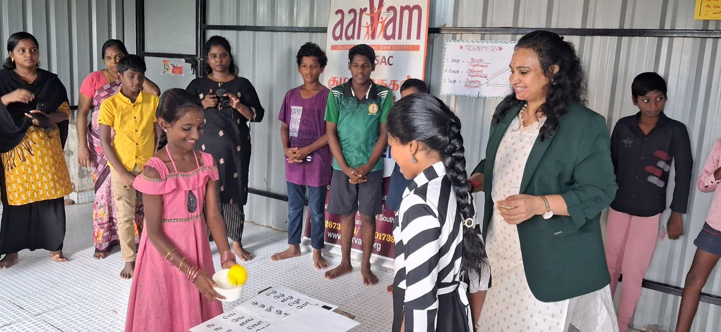
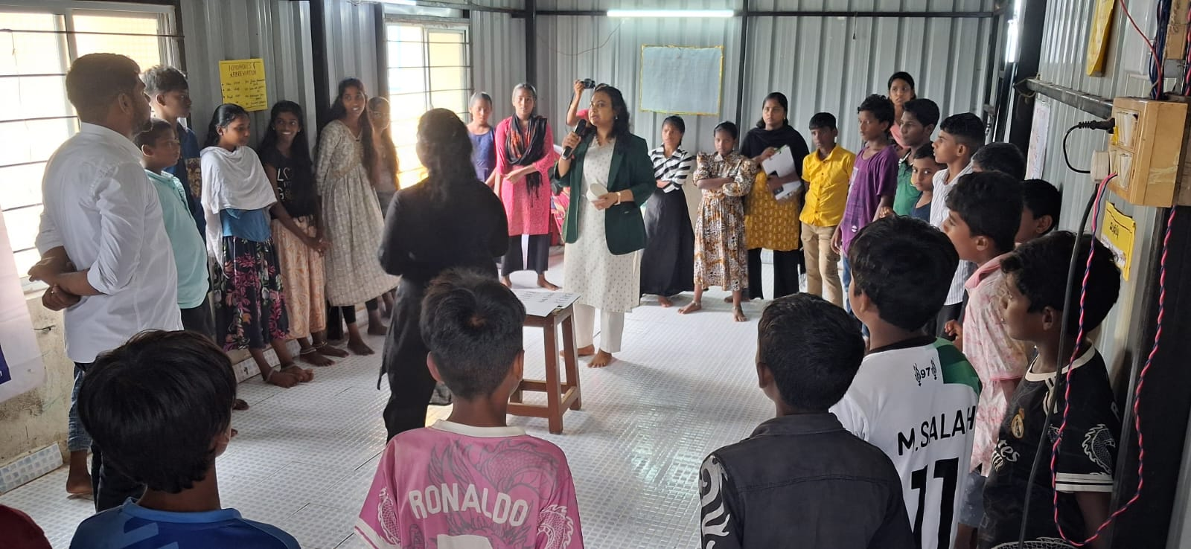
Special Mental Health Workshop
Duration: 2 days | Facilitator: Social work psychologist
Theme: Resilience, self-esteem, and emotional regulation
Approach: Group exercises, mindfulness, and role plays
Impact:
  Students became more expressive and confident.
  Strengthened mental health awareness among adolescents and teachers.

Slide 6
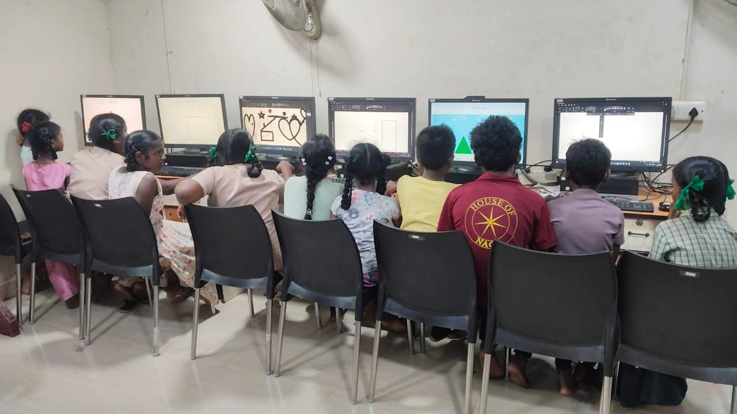
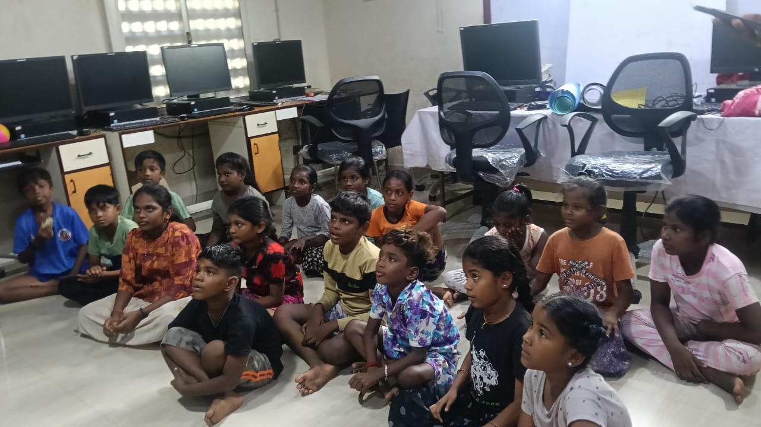
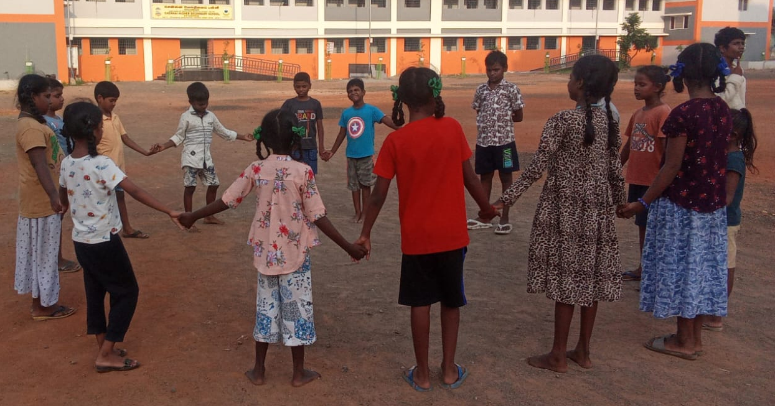
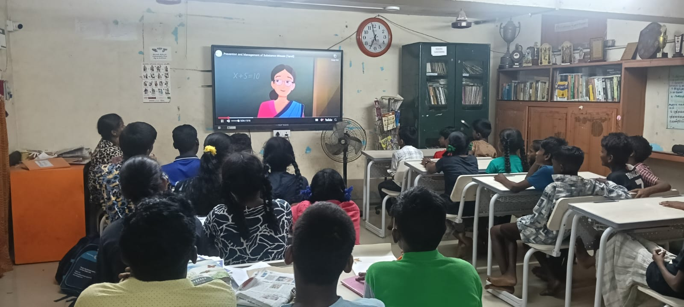
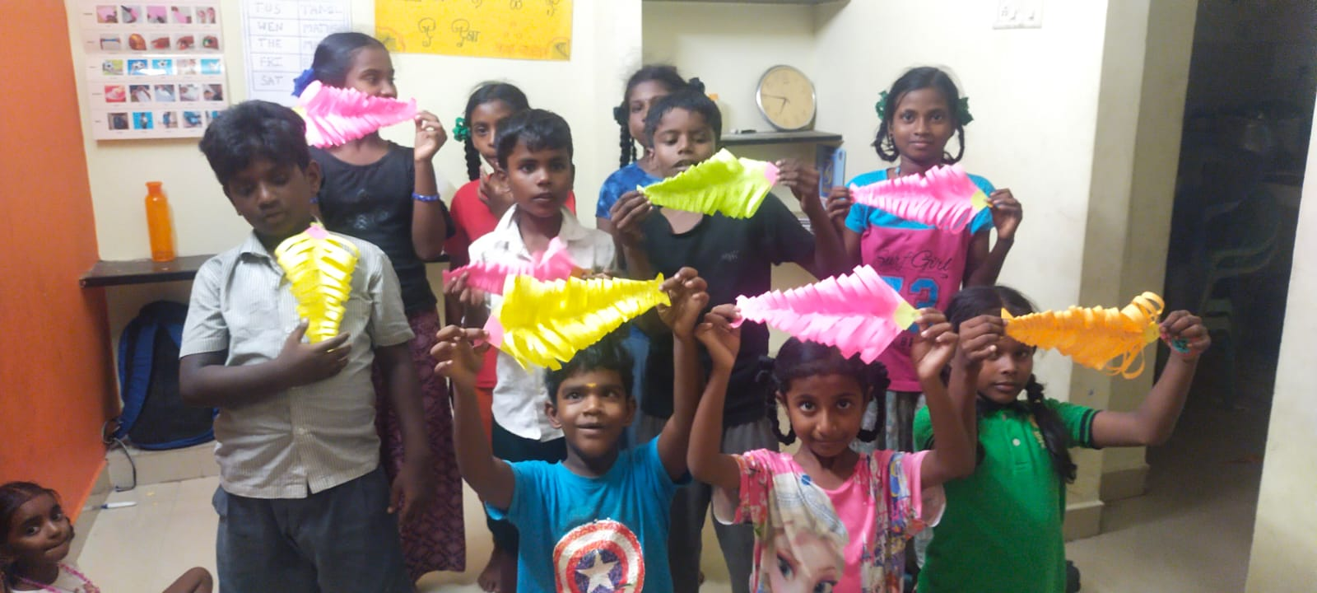
Computer Education Program
Current Batch: 33 adolescents undergoing training in Basic Computer Skills and Typing Practice (sessions held twice weekly).
New Enrolment: 27 youths registered for the upcoming batch in November 2025.
Focus: MS Office, internet literacy, and online communication.
Outcome: Improved digital literacy and employability readiness.
Play way activity : Carrom, shuttlecock, library activities, and movie screenings for children from 3rd to 8th std daily from 5 pm to 6pm.

Slide 7
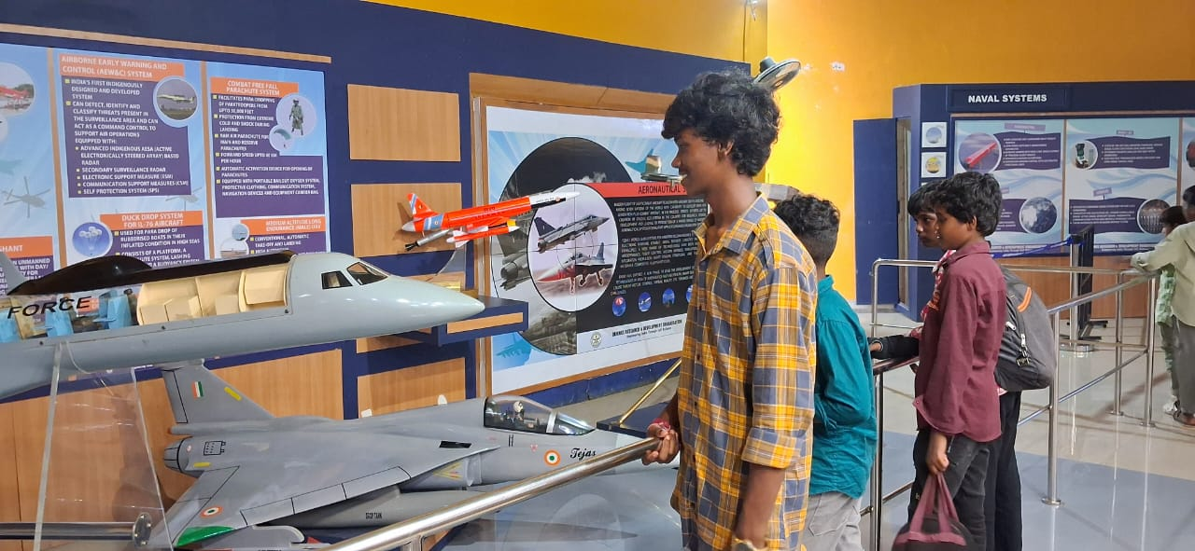
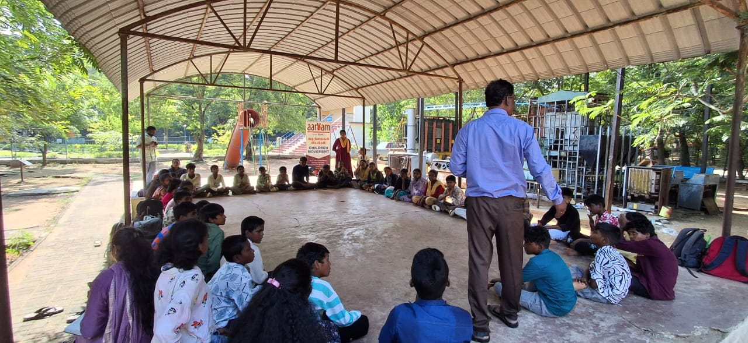
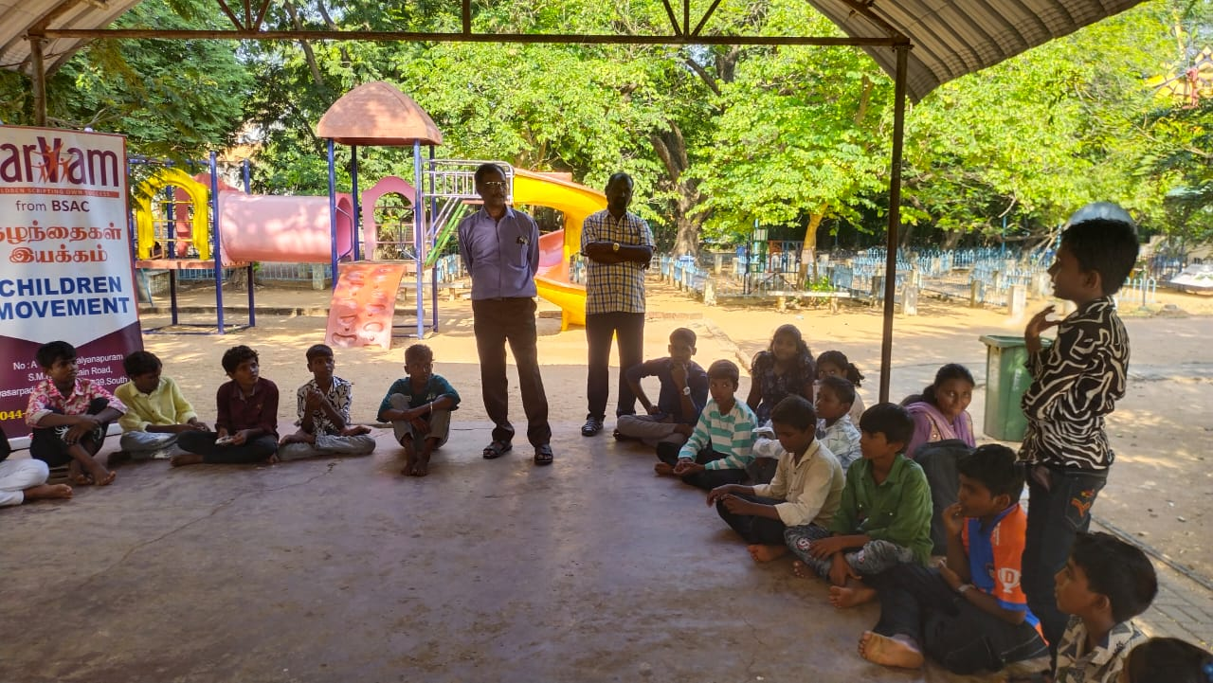
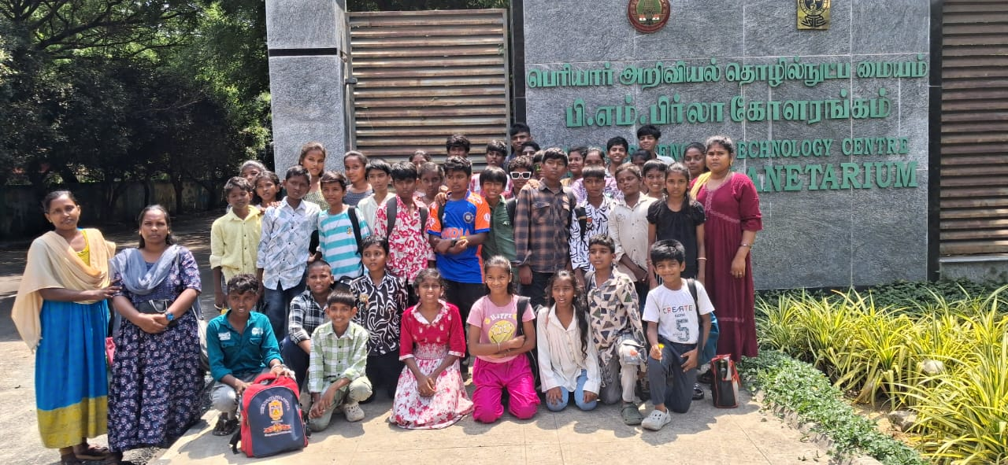
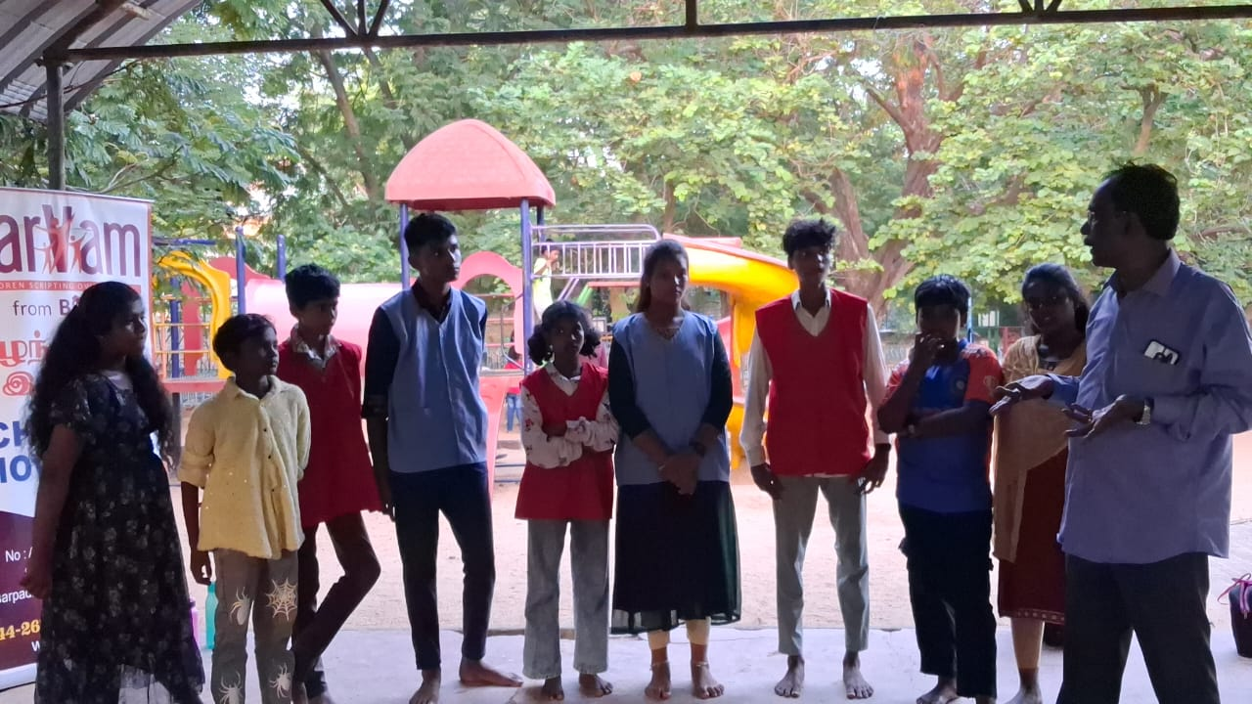
Children Sangam Activities
a. Peer Group Leaders’ Meetings
Conducted every 2nd and 3rd Saturday at cluster level.
Focused on children’s participation in decision-making, discussion of community issues, and planning child-led activities.
Encouraged leadership, problem-solving, and communication skills among children.
Education & Leadership
Children Sangam Activities
• 4 clusters | 160 children
• Activities: Social mapping on drug issues, “Know Yourself,” “Know Your Rights”
• Leadership elections: 7 peer leaders elected
• Exposure Visit: Planetarium & Periyar Science & Technology Centre (36 peer leaders participated).
Children Sangam provided a platform for children to speak out - they identified community issues, gained knowledge about their rights, and developed the skills and confidence needed to become future leaders

Slide 8
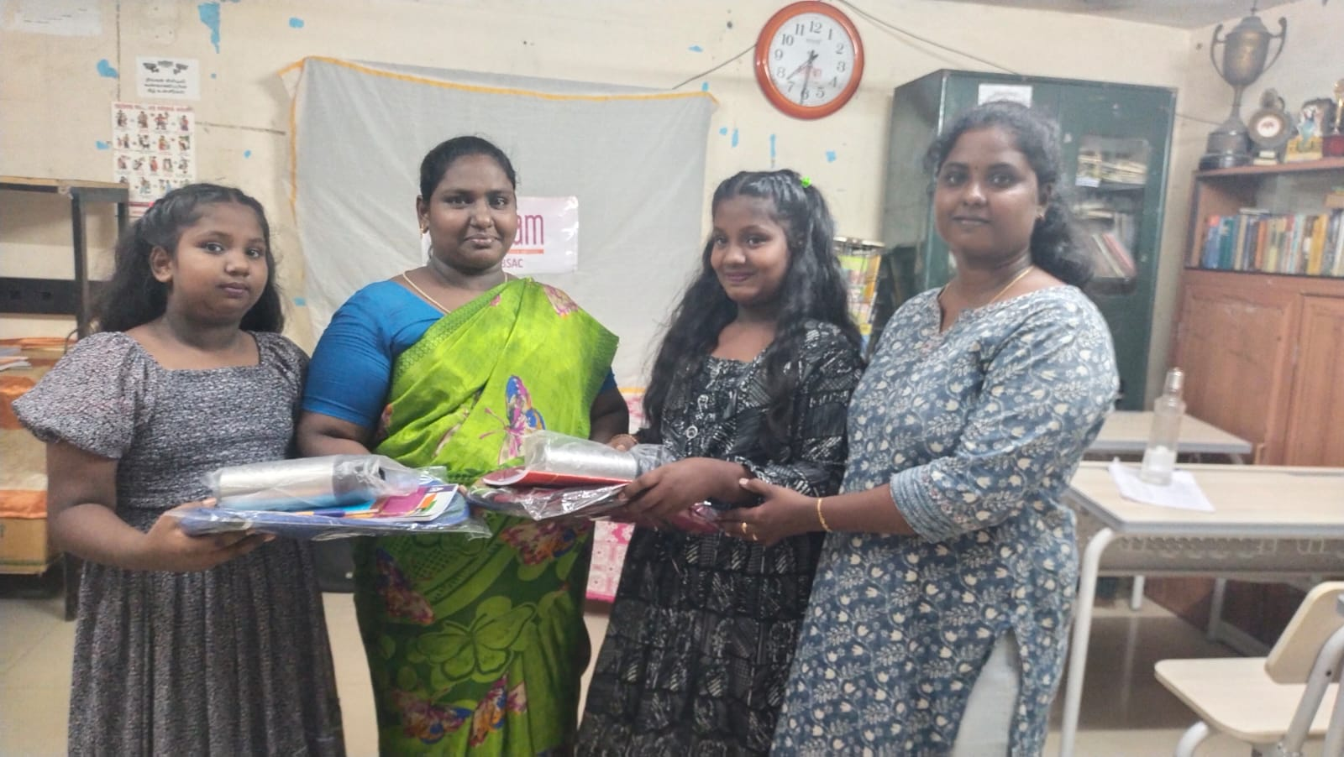
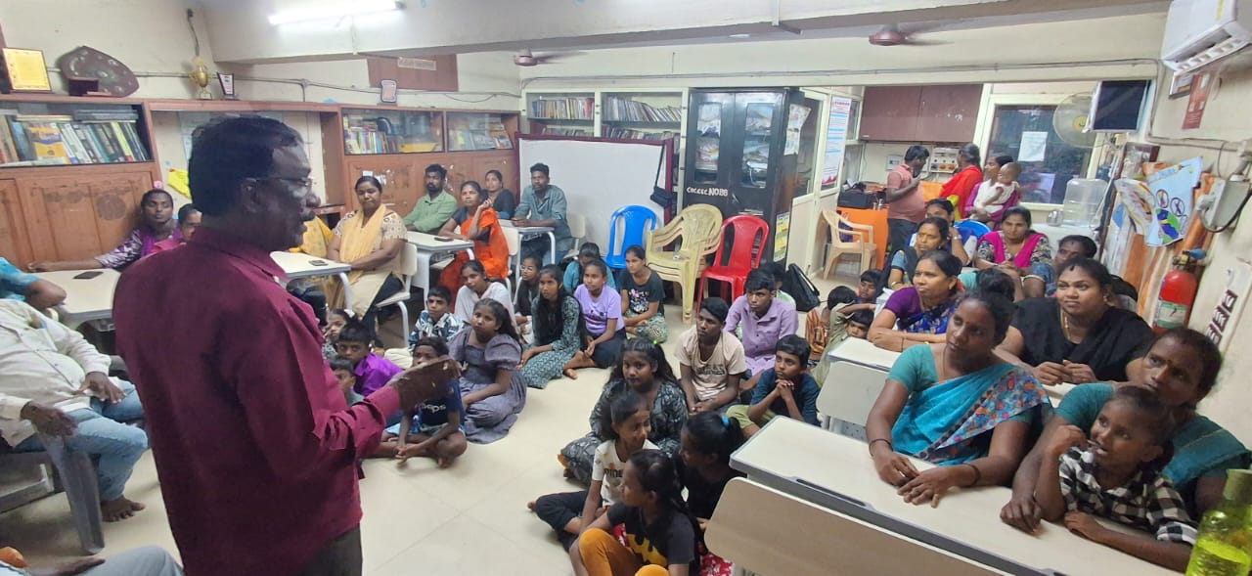
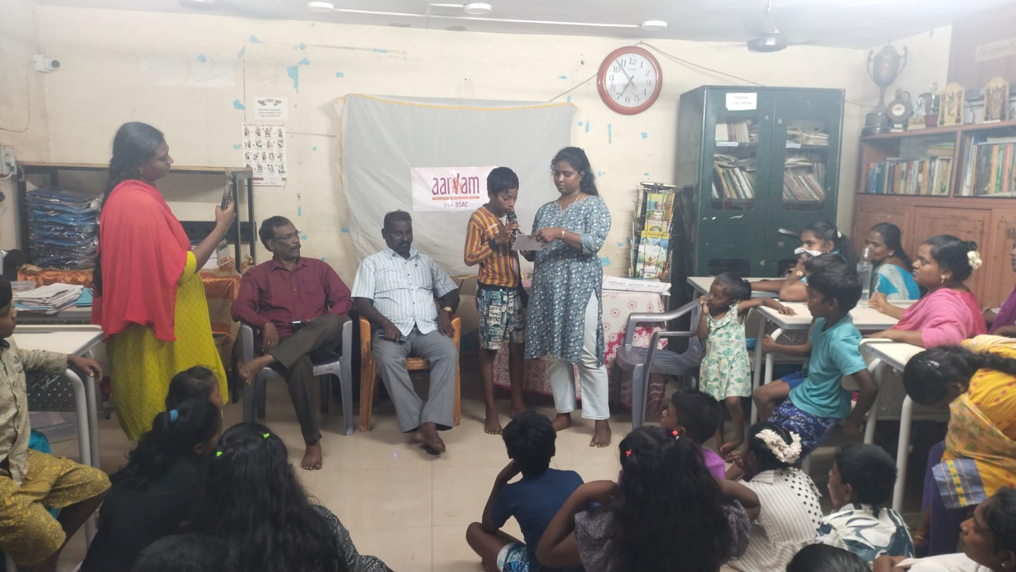
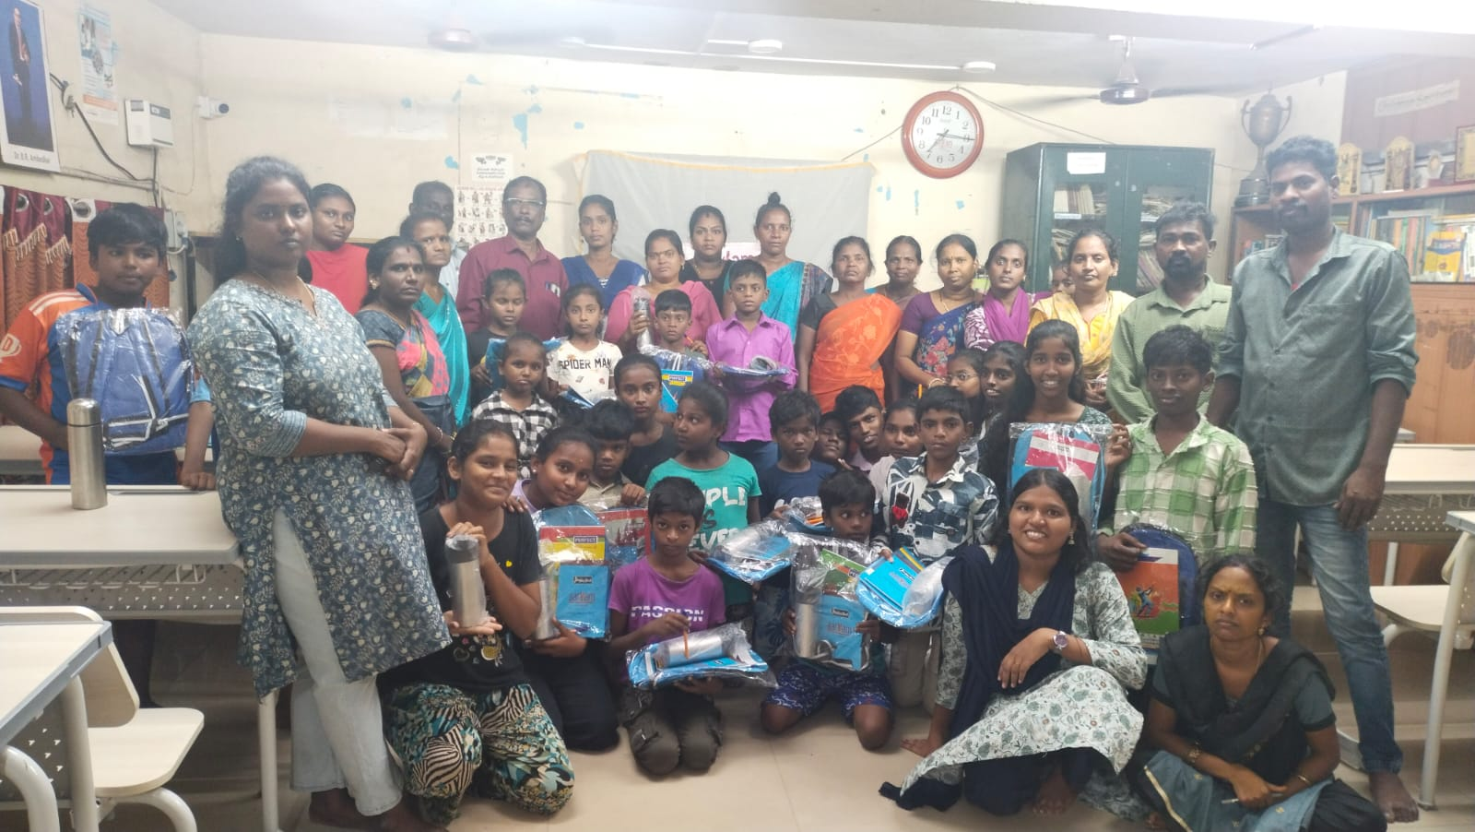
Education Kit Distribution Program
Date: 24th September 2025
Beneficiaries: 48 children actively involved in BSAC programs
Materials Distributed: School bag, water bottle, notebooks, pen, and stationery set
The event also included a parent interaction session, where children showcased their skills and learnings through cultural performances and storytelling.
Objective:
To motivate regular participation in learning programs and to support children’s educational continuity.
Outcome:
Increased parental engagement and pride in children’s progress.
Encouraged regular attendance and motivated children to continue learning.

Slide 9
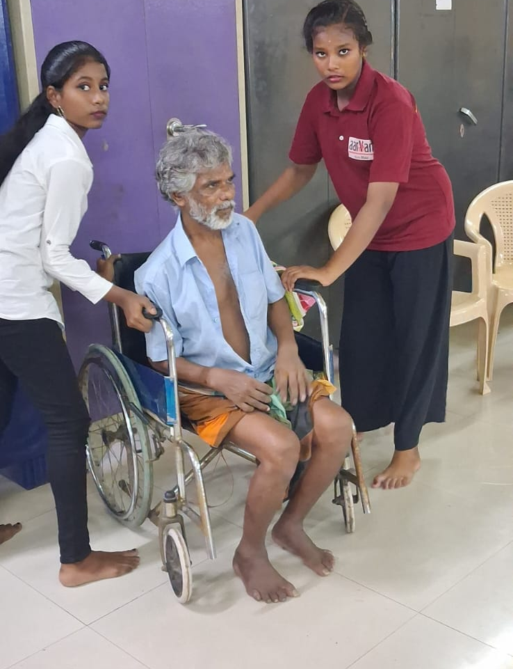
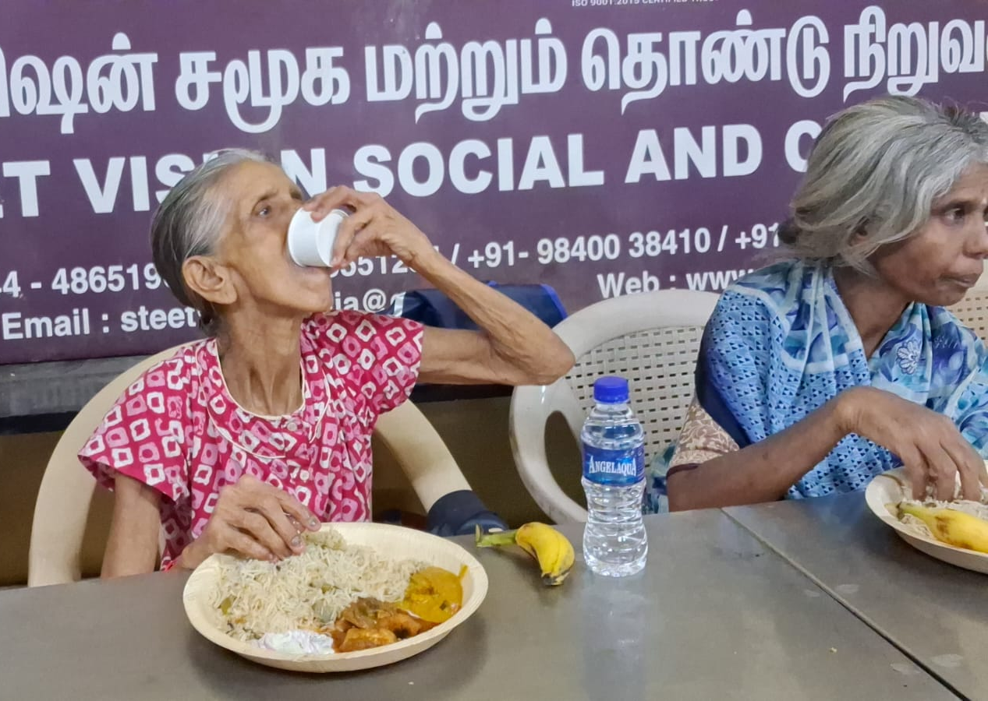
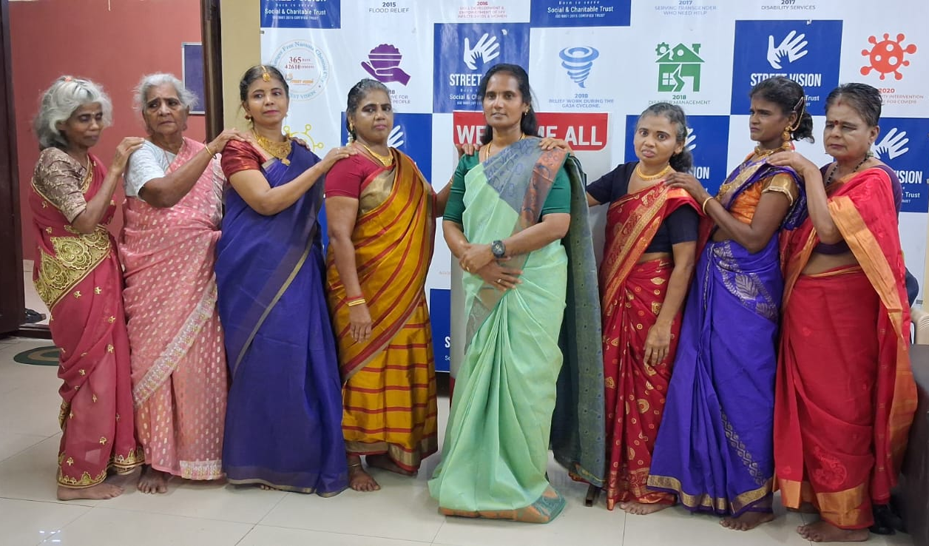
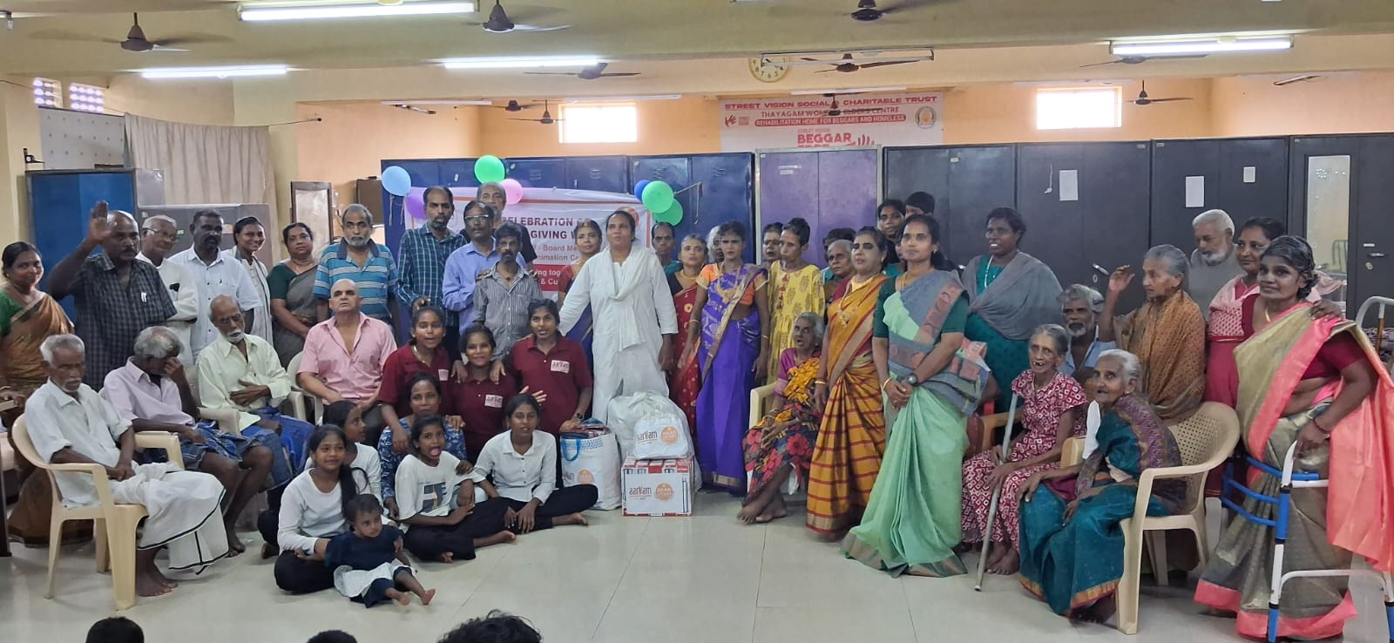
Joy of Giving Week Celebration (October 2025)
Aarvam celebrated the Joy of Giving Week by organizing a heartwarming day of service and connection.
Activities Conducted:
Visit to an Elders’ Home where Aarvam beneficiaries performed cultural programs (dance, songs, skit, puppet show).
Women from the Beautician Course offered grooming and makeup sessions to elders, followed by a joyful ramp walk.
Fundraising activity to support elders’ home and orphaned children – donation of blankets, water bottles, bags, and stationery, and a community lunch.
Impact:
Strengthened values of empathy, compassion, and social responsibility among youth.
Promoted intergenerational bonding and volunteerism.

Slide 10
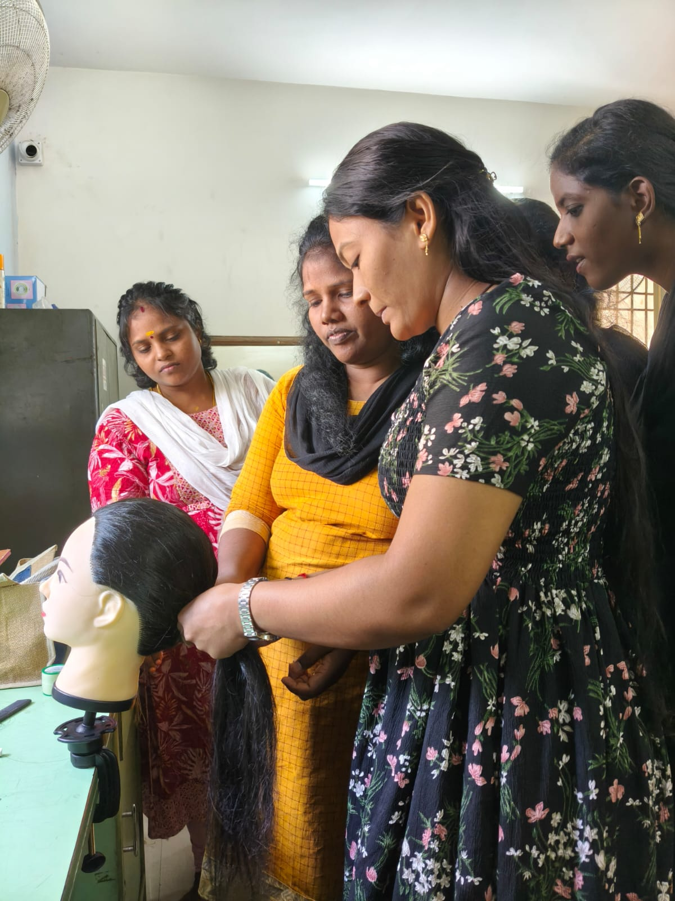
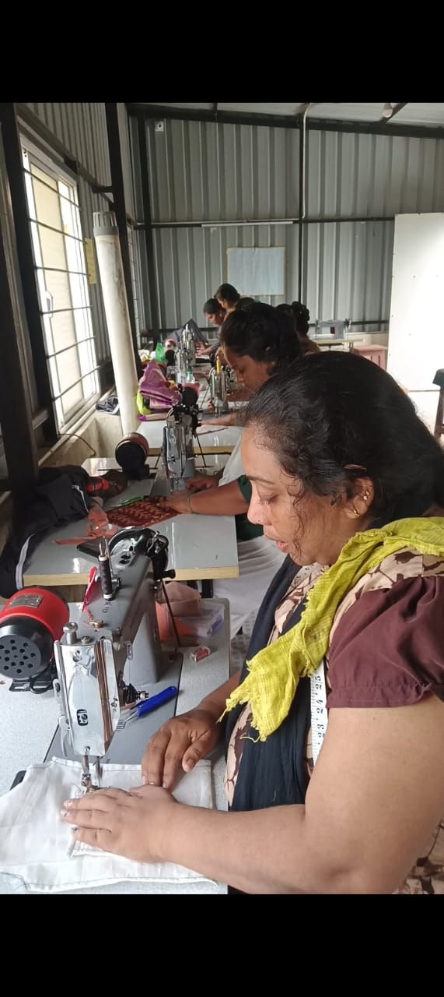
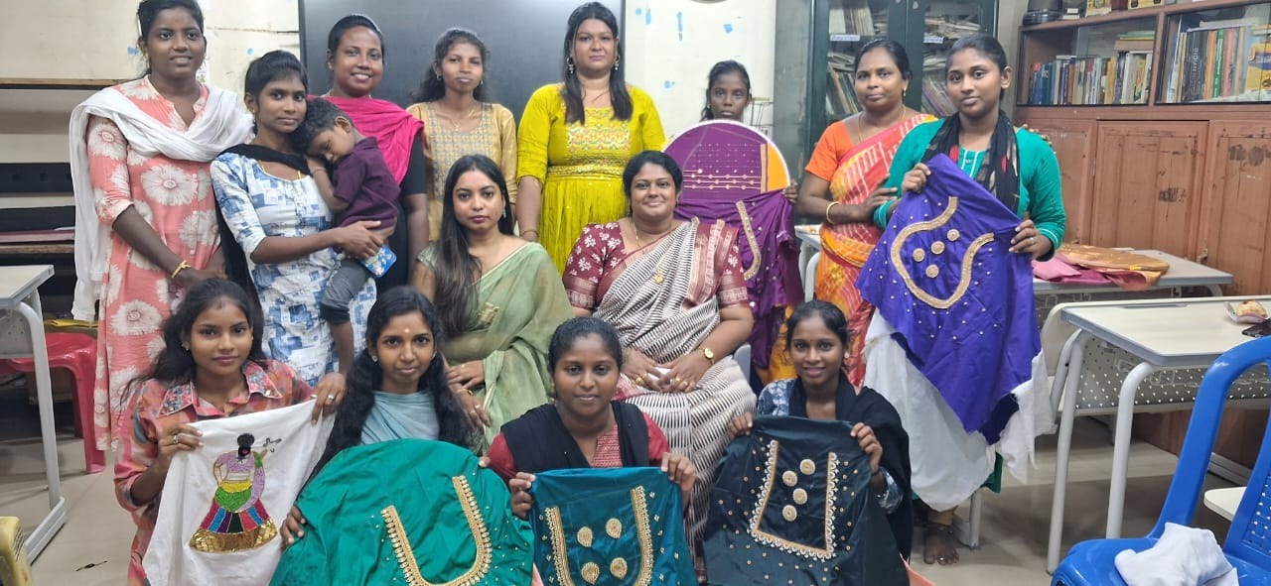
Women Development Program
Beautician & Aari Training:
  2nd batch (22 women) successfully completed training.
  3rd batch commenced with enthusiastic participation.
New Tailoring Classes: Started in November to expand livelihood opportunities for women.
Outcome: Women gain income-generating skills, confidence, and community recognition.

Slide 11
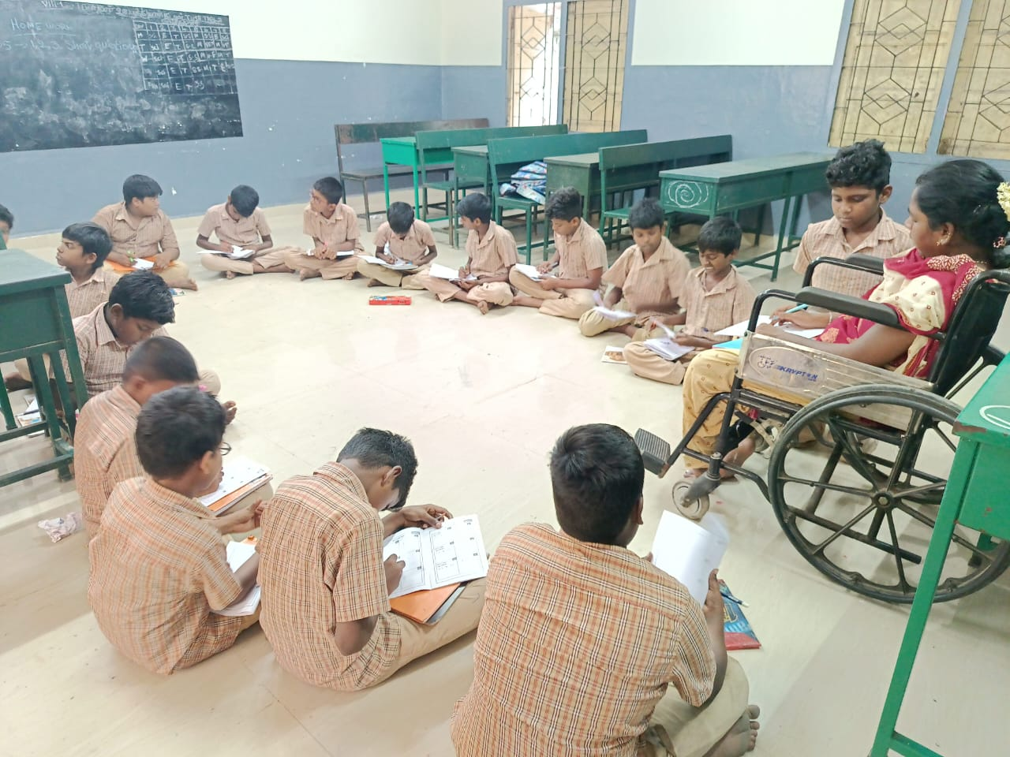
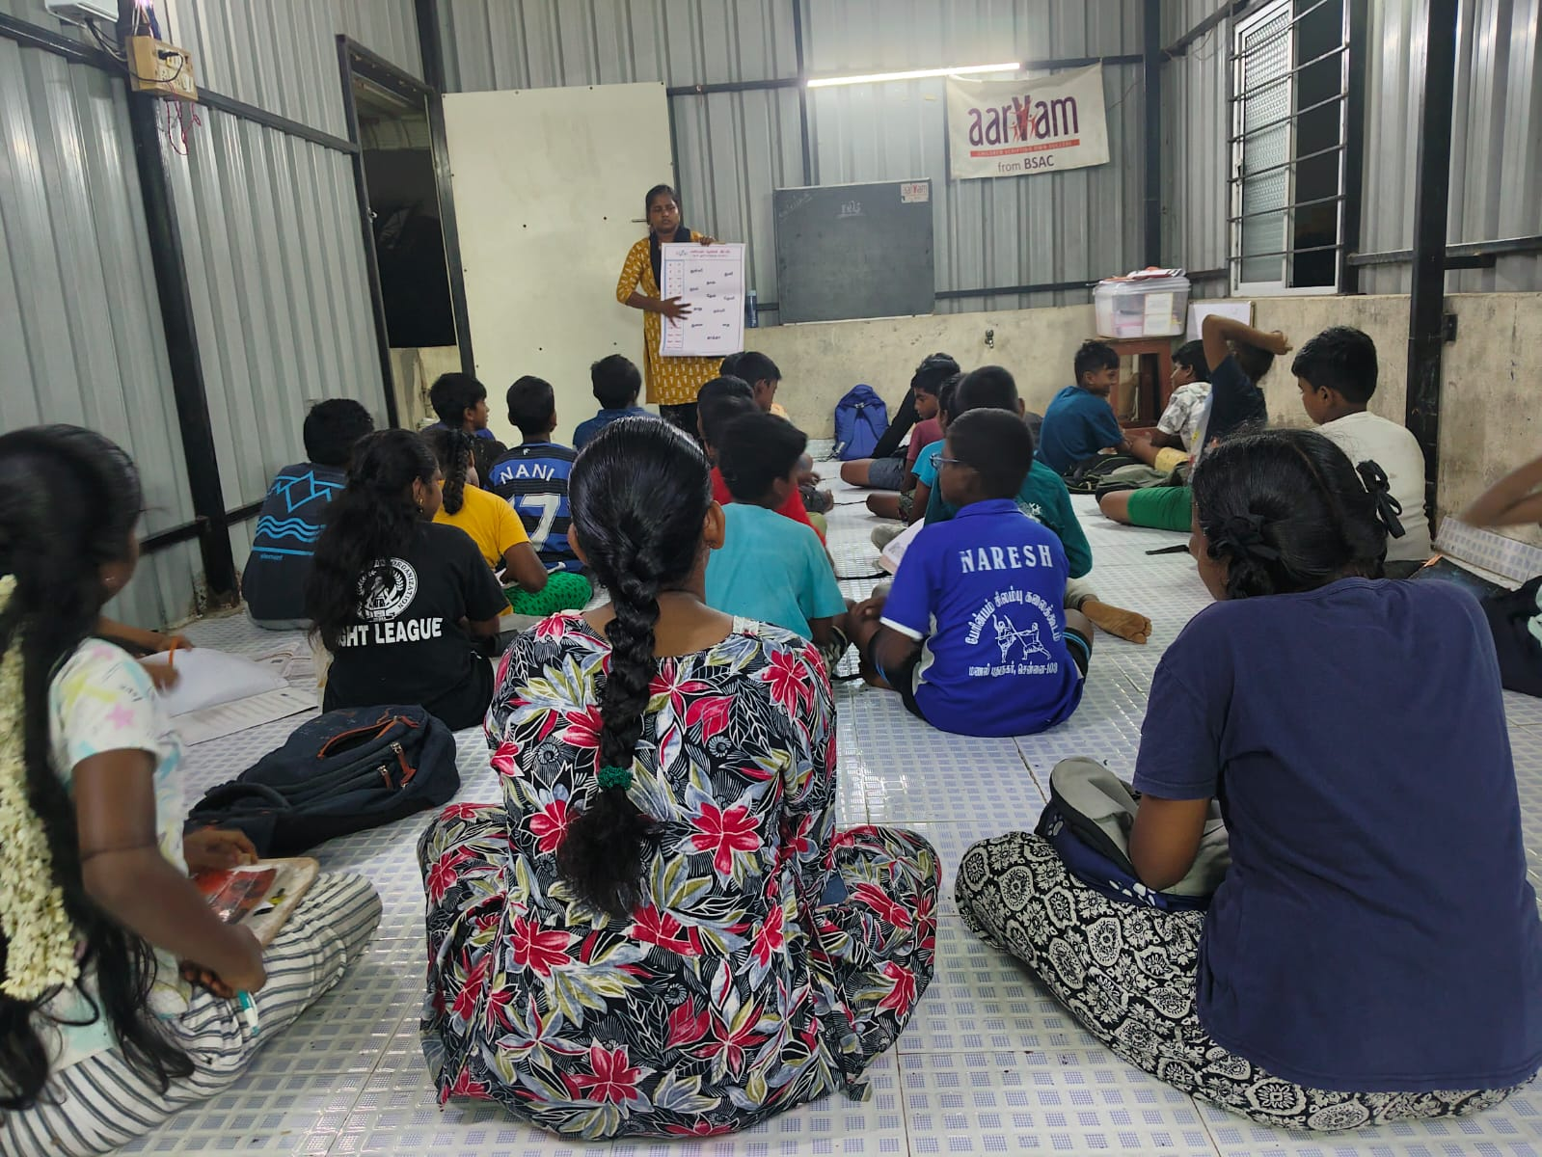
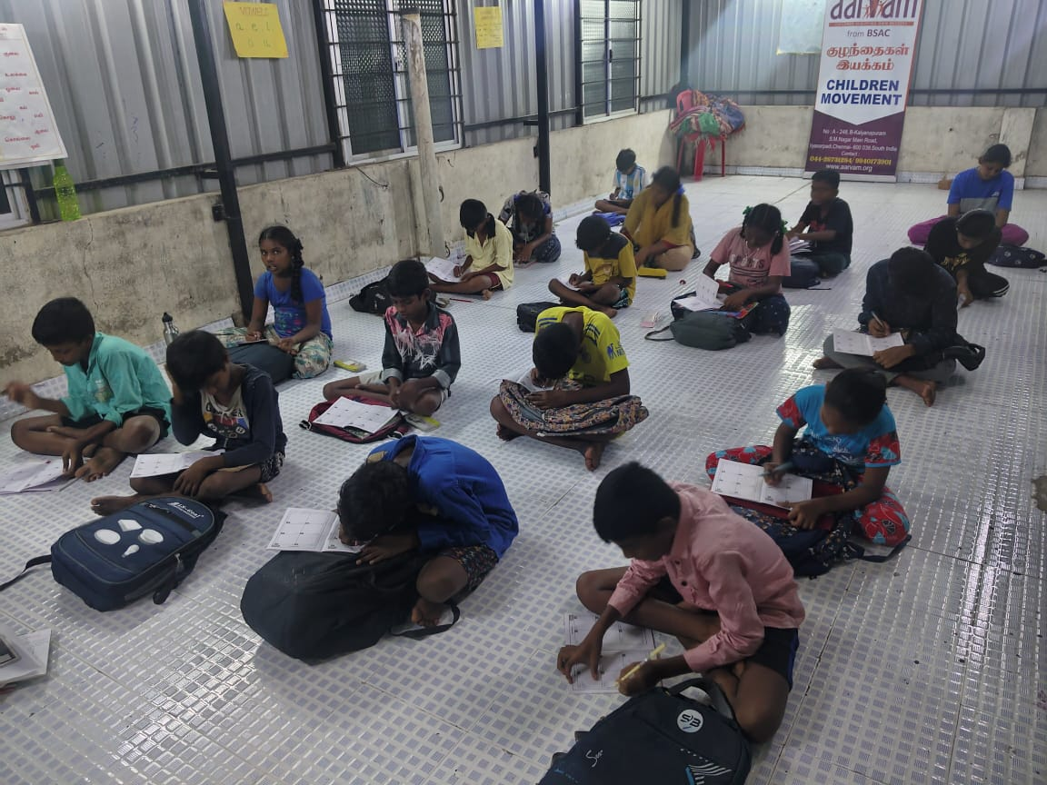
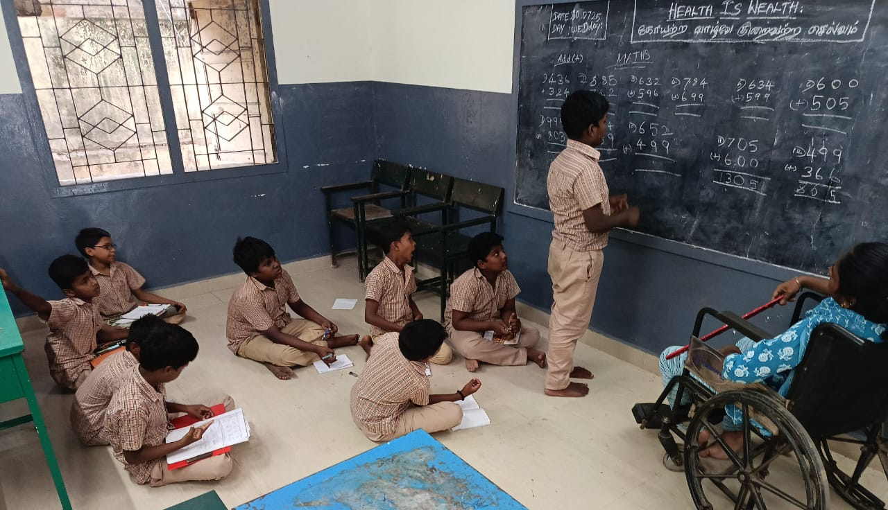
Supplementary Education Centre
S.No | Std | No.of children
1 | 1st to 2nd (Community ) | 6
2 | 3rd to 5th (Community) | 30
3 | 3rd to 5th (School) | 26
4 | 6th to 8th (Community) | 46
5 | 6th to 8th (School) | 29
6 | 9th and above | 16
 | Total | 153

Slide 12
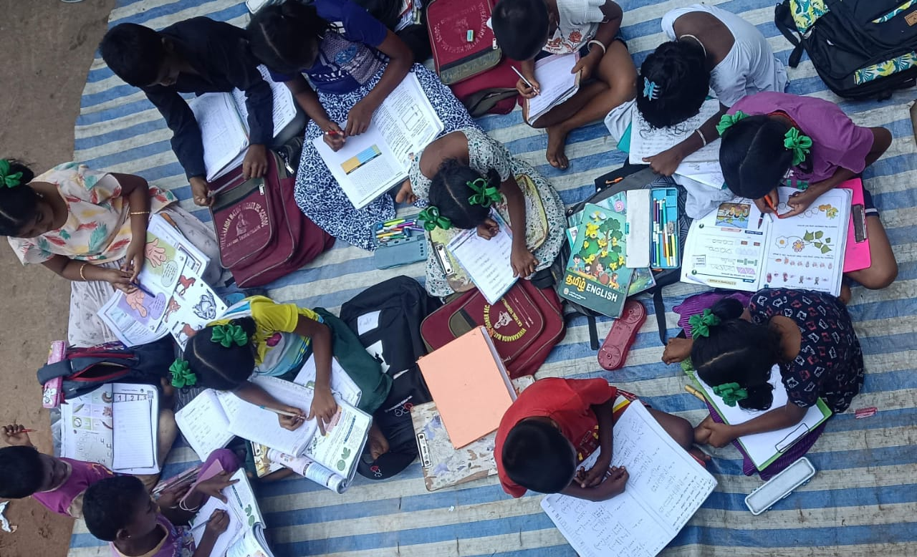
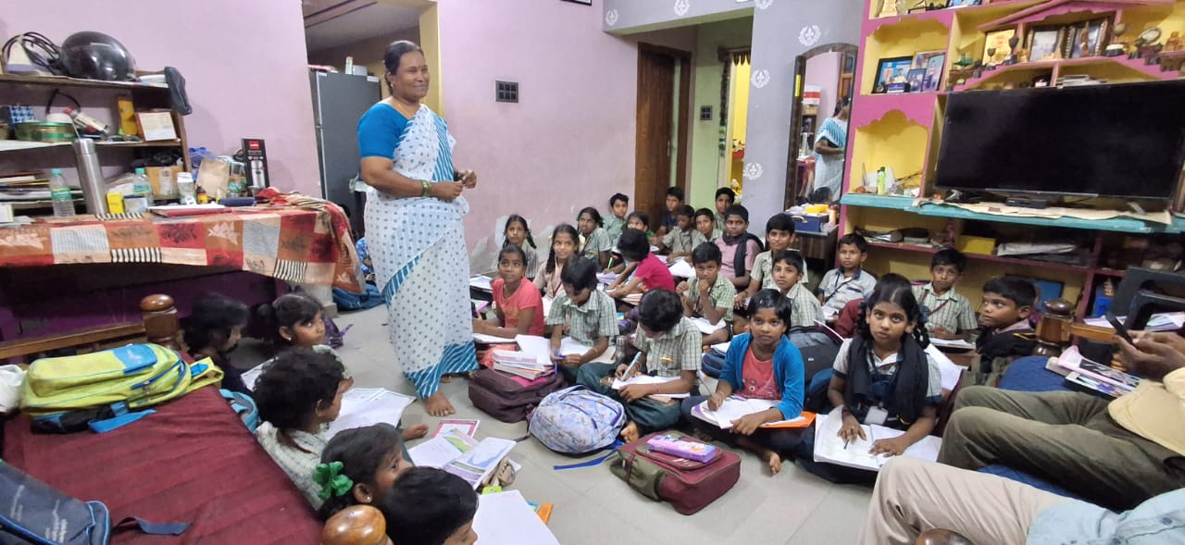
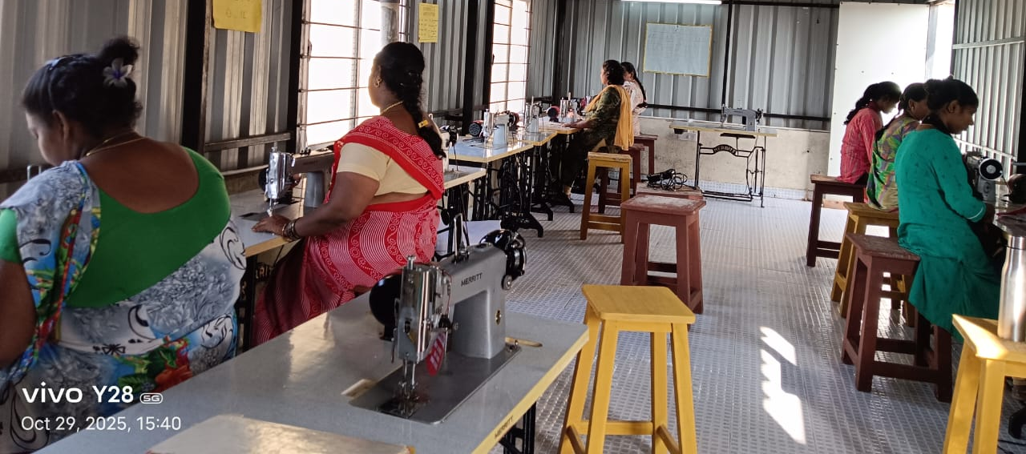
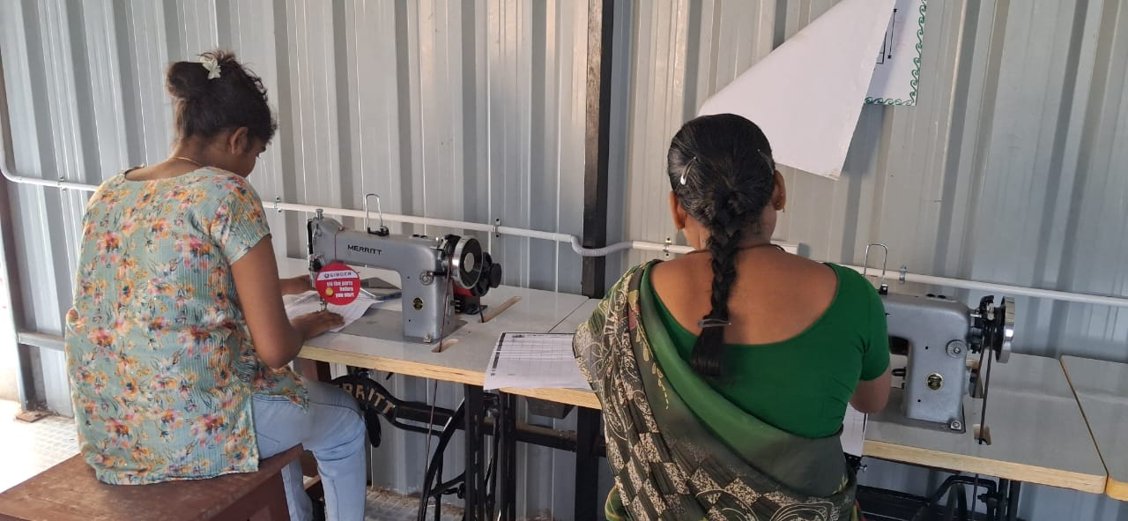
New Initiatives
Supplementary Education Pilot:
  Launched 5 new centers at Gummidipoondi and Thervoykandigai, benefiting 150+ children.
Tailoring Class (from Nov 1): Begun alongside Aari and Beautician courses to enhance women’s vocational skills.
BSAC Impact Study: 40-year legacy study initiated to reconnect with past beneficiaries and establish an Alumni Network to promote mentorship and sustainability.

Slide 13
Way Forward
Program Expansion: Extend Aarvam and BSAC initiatives to new underserved locations based on emerging community needs.
Holistic Skill Development: Strengthen integrated programs for children and youth combining education, life skills and arts.
Volunteer Engagement: Mobilize more community and student volunteers to support center activities.
BSAC Alumni Network: Formally establish an alumni group to mentor current beneficiaries and foster knowledge exchange.
NGO Partnership Network: Build a network of organizations founded by BSAC alumni, supporting them in advancing community development initiatives.
Government Linkages & Certification: Partner with government departments, and recognized institutions for skill certification and scheme linkage to increase women’s employability and program reach.

Slide 14
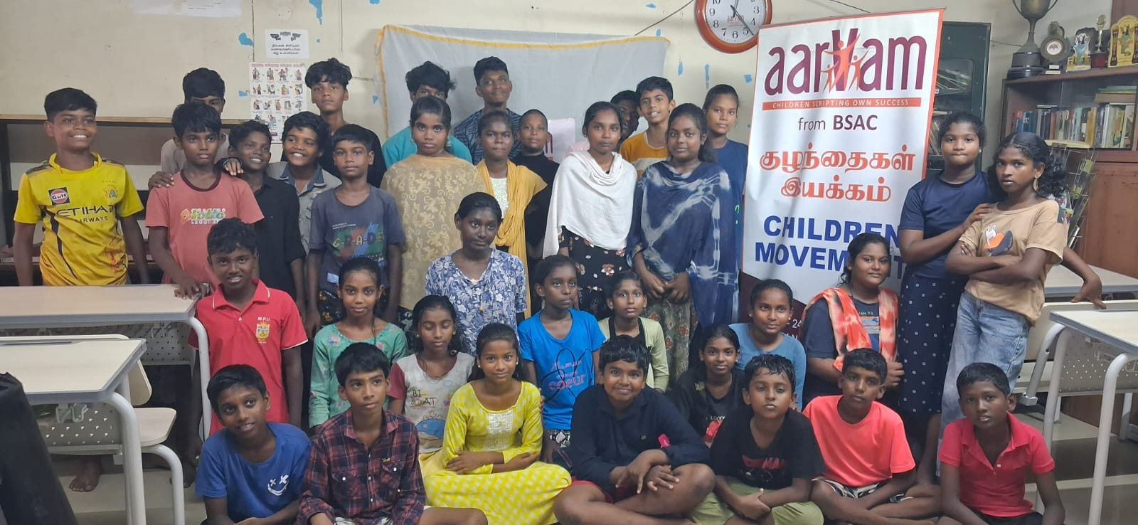


Gratitude
We sincerely thank Chennai Smiles for their continued support and partnership. Your encouragement enables Aarvam to nurture potential, promote wellbeing, and create opportunities for children, youth, and women in vulnerable communities.

